Slide 1
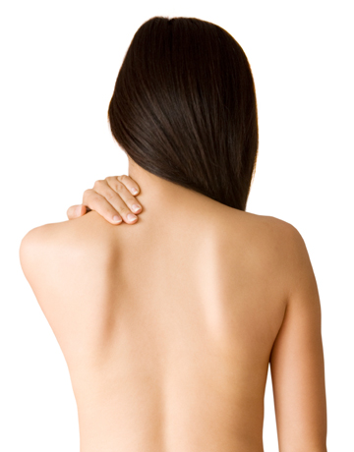
The Integumentary System

Slide 2
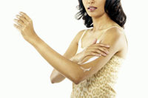
The Skin
Functions
regulation of body temperature
protection – a physical barrier and for water conservation
sensation - varied sensory nerve endings
communication – to other humans by signals/expressions and by touch
excretion – in sweat = H₂O, salts, small organic compounds (a minor contribution to excretion)
immunity – certain phagocytes in the epidermis are important from the immune system for defense
synthesis of Vitamin D – for calcium absorption

Slide 3
The Skin
Parts
2 Principal portions
Epidermis - epithelium
Dermis – areolar and dense irregular
fibrous connective tissue
3. Hypodermis
  “beneath the dermis”
  the subcutaneous layer next to:
    adipose layer or
    muscle or
    bone

Slide 4
The Skin
Parts
4 cell types
  Keratinocytes - 90%
    waterproof barrier
  Melanocytes - 8%
    produce melanin (pigment)
  Langerhans cells
    phagocytes (from immune system)
  Merkel cells
    sensory transduction - touch

Slide 5
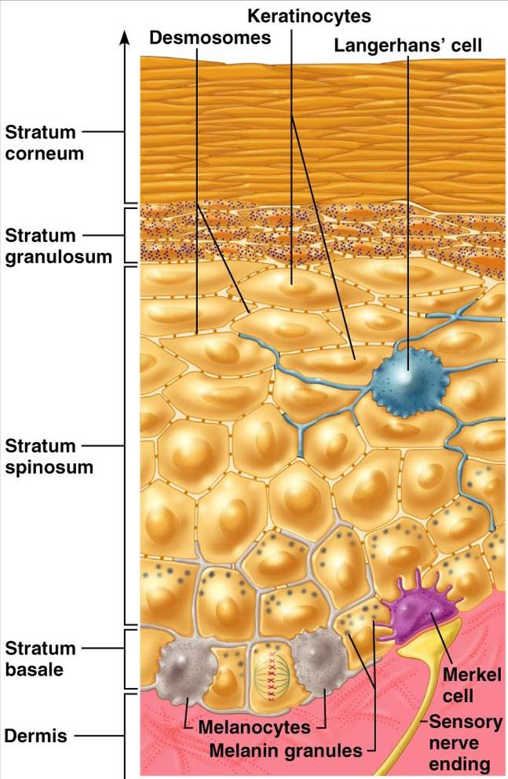
The Skin
Layers of the Epidermis
Stratum basale
Stratum spinosum
Stratum granulosum
Stratum lucidum
Stratum corneum
2-4 weeks for each cell
to form and to move from
the stratum basale to the
surface

Slide 6
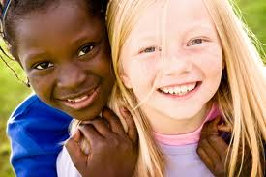
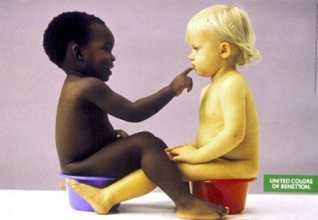
The Skin
Skin Pigments
Melanin - yellow to black
2. Carotene - yellow-orange pigment in the
dermis
3. Hemoglobin – because the skin is
translucent
- tinted red to pink depending
on dermal capillary blood flow

Slide 7
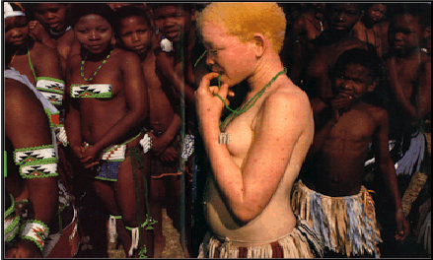
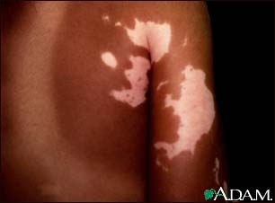
The Skin
Common Diseases
Albinism - inability to produce melanin; cannot breakdown tyrosine, no melanin, inborn error of metabolism
Vitiligo - partial/complete loss of melanocytes from skin patches

Slide 8
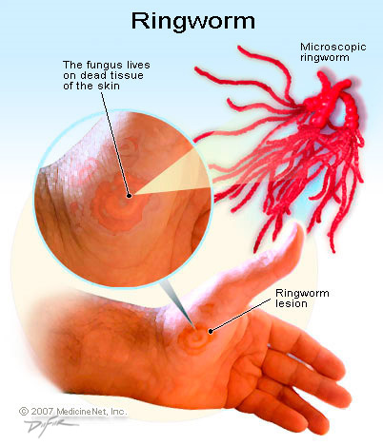
The Skin
Common Diseases
Ringworm is a fungal infection of the skin previously thought to be due to a parasite (worm). The medical term for ringworm is tinea. The skin infections are sometimes characterized by round lesions in the upper layers of the skin. Fungi that cause ringworm are known as dermatophytes.
Treatment
Antifungal ointment or creams

Slide 9
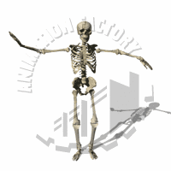
The Skeletal System

Slide 10
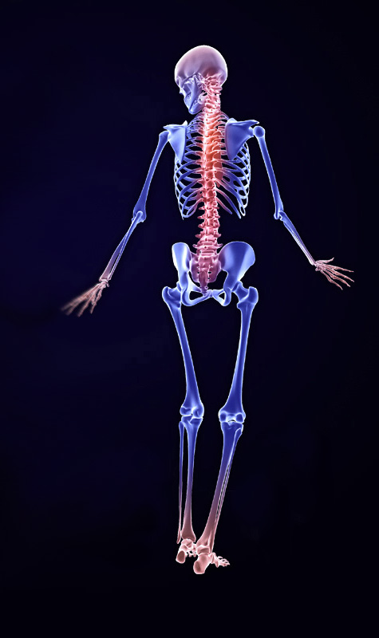
The skeletal system functions of the human body include:
Support
Protection
Helping in movement
Storage of minerals
Production of red blood cells
Chemical energy storage

Slide 11
The Skeletal System
SUPPORT
Provides support to the body
provides framework for attachment
Maintains normal Ca⁺ and PO₄
concentration inthe body fluids
stores glycerides where yellow one
marrow are present
STORAGE
BLOOD CELL
PRODUCTION
produce RBC & WBC where red
marrow are present
PROTECTION
protects the internal organs
LEVERAGE
act as levers that changes the magnitude
& direction of the skeletal muscles

Slide 12
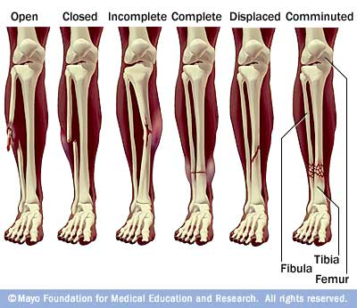
Common diseases
1. Types of Fractures (and their causes)
A fracture is breakage of a bone, and it may be complete or incomplete.
The following table summarises six types of fracture.

Slide 13
Common diseases
1. Types of Fractures (and their causes)
cominuted
A fracture in which the bone is broken into more than two pieces.
A crushing force is usually responsible and there is extensive injury to surrounding soft tissues is common.
impacted
A fracture in which the bones involved are driven into each other.
complicated
A broken bone that also involves damage to other organs - in addition to broken Bone(s) and possibly also broken skin. An example is a broken rib that punctures a lung.

Slide 14
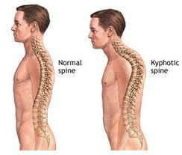
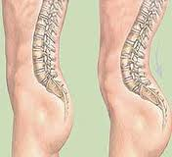
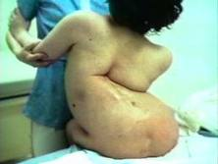
Common diseases
2. Postural Deformities
kyphosis
Excessive outward curvature of the spine, causing hunching of the back.
Lordosis
Inward curvature of the spine.
Some lordosis in the lumbar and cervical regions of the spine is normal.
Exaggerated lordosis may occur in adolescence - possibly as a result of faulty posture, or due to disease affecting the vertebrae and spinal muscles.

Slide 15
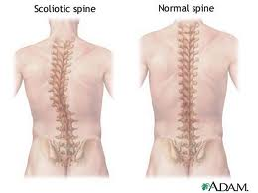
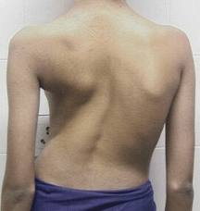
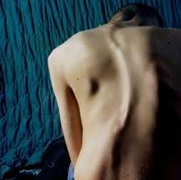
Common diseases
2. Postural Deformities
scoliosis
Lateral (sideways) deviation of the spine.
Scoliosis may be caused by congenital or acquired abnormalities of the vertebrae, muscles, and/or nerves.
Treatment may involve the use of spinal braces and, in cases of severe deformity. surgical correction by fusion or osteotomy.

Slide 16
Common diseases
3. Other Skeletal Conditions (and their
causes and effects)
CONDITION | CAUSE | EFECT
ARTHRITIS Inflammation of one or more joints | osteoarthritis rheumatoid arthritis gout tuberculosis, and other infections. | Swelling, warmth, redness of the overlying skin, pain, restriction of motion.
RHEUMATOID ARTHRITIS (The second most common form of arthritis, after osteo arthritis) | Rheumatoid Arthritis is a disease of the synovial lining of joints: The joints are initially painful, swollen, and stiff and are usually affected symmetrically. | As the disease progresses the ligaments supporting the joints are damaged and there is erosion of the bone, leading to deformity of the joints. Tendon sheaths can be affected, leading to tendon rupture.

Slide 17
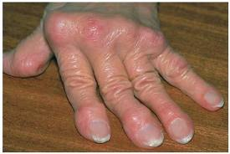
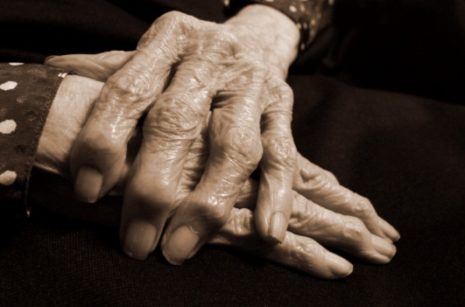
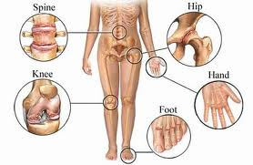
Common diseases
3. Other Skeletal Conditions (and their
causes and effects)
CONDITION
ARTHRITIS Inflammation of one or more joints
RHEUMATOID ARTHRITIS (The second most common form of arthritis, after osteo arthritis)

Slide 18
Common diseases
3. Other Skeletal Conditions (and their
causes and effects)
CONDITION | CAUSE | EFECT
BONE CANCER | Bone cancer may occur as a secondary cancer from, for example, prostate cancer | Damage to stem cells (the cause of leukaemia).
GOUT | Gout is caused by a defect in uric acid balance in the metabolism - resulting in an excess of the acid and its salts (urates) which then accumulate in the bloodstream and joints, respectively. | chronic destruction of the joints, and deposits of urates (tophi) in the skin and cartilage - especially of the ears. The excess urates also damage the kidneys, in which stones may form.

Slide 19
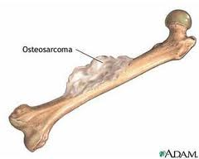
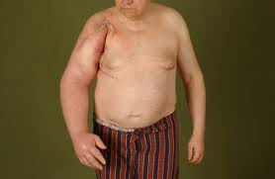
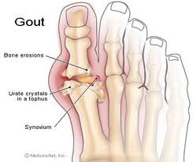
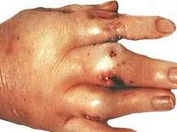
Common diseases
3. Other Skeletal Conditions (and their
causes and effects)
CONDITION
BONE CANCER
GOUT

Slide 20
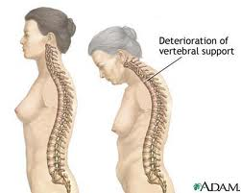
Common diseases
3. Other Skeletal Conditions (and their
causes and effects)
CONDITION | CAUSE | EFECT
OSTEOPOROSIS Loss of bone tissue | Infection, injury and synovitis can cause localized osteoporosis of adjacent bone. Generalised osteoporosis is common in the elderly, and in women often follows the menopause. It is also a feature of Cushing's disease and prolonged steroid therapy | . Bones that are brittle and liable to fracture.

Slide 21
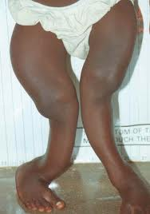
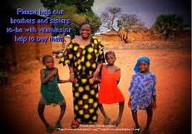
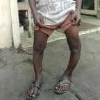
Common diseases
3. Other Skeletal Conditions (and their
causes and effects)
CONDITION | CAUSE | EFECT
RICKETS Childhood disease | Rickets is a childhood condition caused by insufficient vitamin D and Calcium | Bow legs.

Slide 22
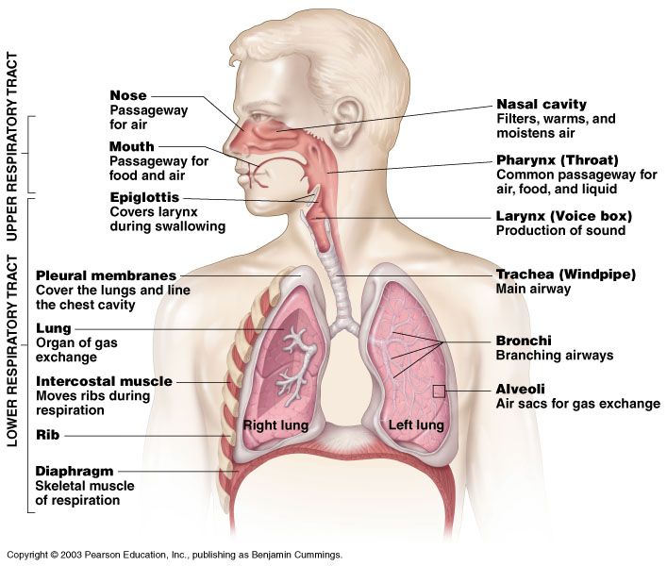
the respiratory system

Slide 23
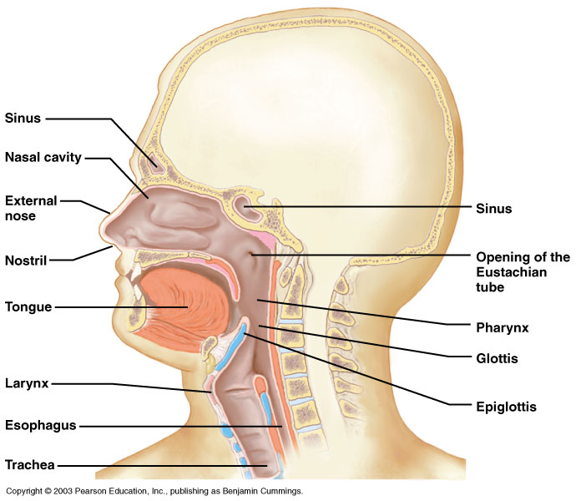
Components of the Upper Respiratory Tract
Figure 10.2

Slide 24
Upper Respiratory Tract Functions
Passageway for respiration
Receptors for smell
Filters incoming air to filter larger foreign material
Moistens and warms incoming air
Resonating chambers for voice

Slide 25
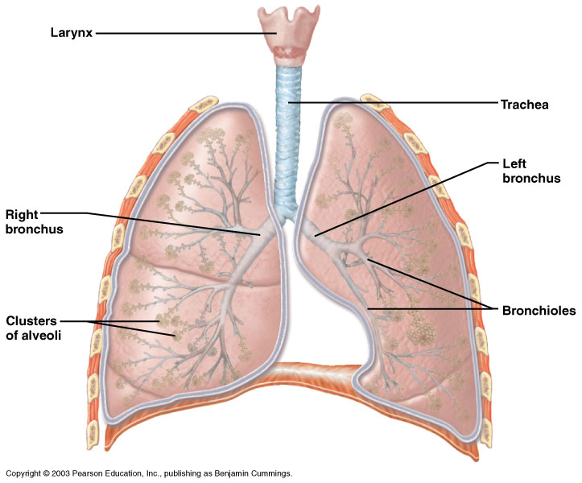
Components of the Lower Respiratory Tract
Figure 10.3

Slide 26
Lower Respiratory Tract
Functions:
  Larynx: maintains an open airway, routes food and air appropriately, assists in sound production
  Trachea: transports air to and from lungs
  Bronchi: branch into lungs
  Lungs: transport air to alveoli for gas exchange

Slide 27
Gas Exchange Between the Blood and Alveoli
Figure 10.8A

Slide 28
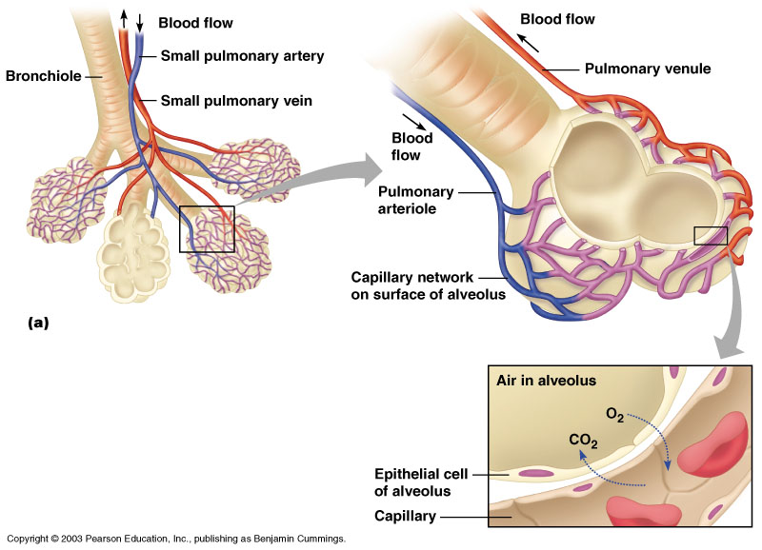
Gas Exchange Between the Blood and Alveoli
Figure 10.8A

Slide 29
Diseases of the Respiratory System
Chronic Obstructive Pulmonary Disease
    Emphysema
    Chronic Bronchitis
Asthma 1
Asthma 2

Slide 30
Diseases of the Respiratory System
Pneumonia

